Slide 1
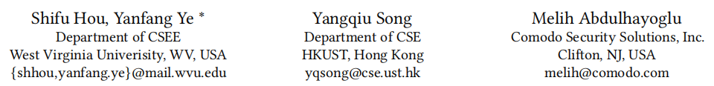
HinDroid: An Intelligent Android Malware Detection System Based on Structured Heterogeneous Information Network

Slide 2
PROBLEM
detect Android malware
The increasing sophistication of Android malware calls for new defensive techniques that are capable against novel threats and
harder to evade.

Slide 3
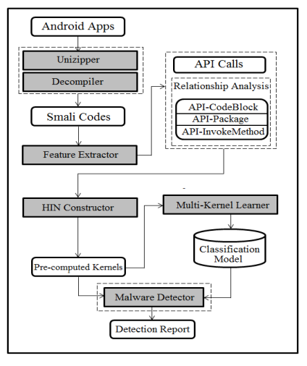
SYSTEM
ARCHITECTURE

Slide 4
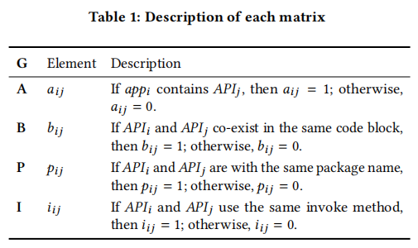
HinDroid
Feature Extraction
API Call Extraction
Relationship Analysis among the Extracted API Calls
Notes:
API calls are used by the Android apps in order to access operating system functionality and system resources. therefore, they can be used as representations of the behaviors of an Android app.
(1) invoke-static: invokes a static method with parameters; (2) invoke-virtual: invokes a virtual method with parameters; (3) invoke-direct: invokes a method with parameters without the virtual method resolution; (4) invoke-super: invokes the virtual method of the immediate parent class; and (5) invokeinterface: invokes an interface method.

Slide 5
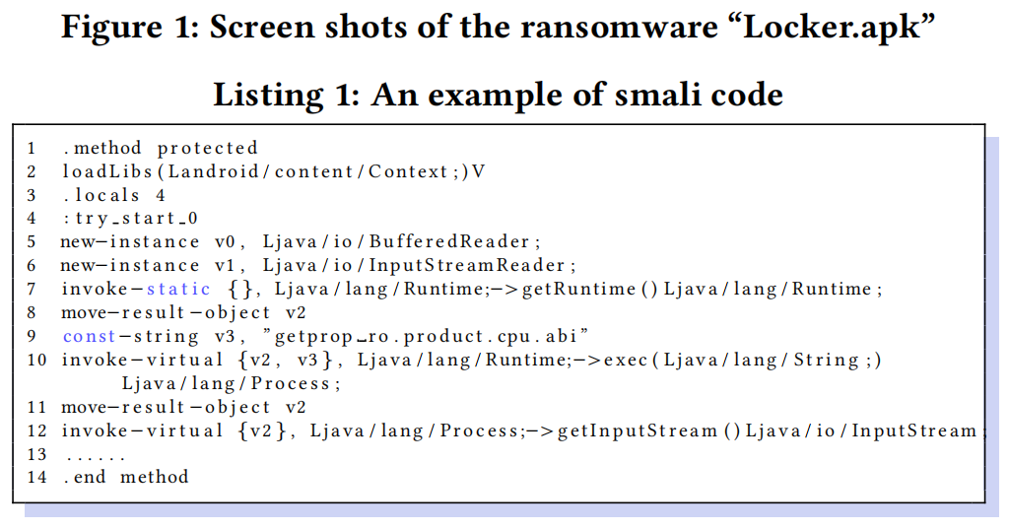
API-Package
the same package “Ljava/lang/Runtime”

Slide 6




HinDroid
HIN Construction
A heterogeneous information network
The network schema
A=2, R=4
meta-path P
a commuting matrix M_{P}
(AA^{T})

Slide 7


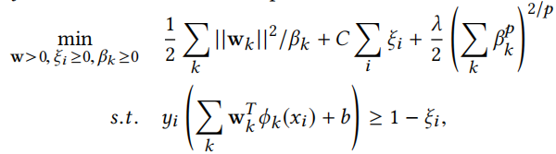



HinDroid
Multi-Kernel Learning
K meta-paths P_{k}
objective function
Notes:
ξi is introduced to allow mis-classification.
[23] S. V. N. Vishwanathan, Zhaonan sun, Nawanol Ampornpunt, and Manik Varma.2010. Multiple Kernel Learning and the SMO Algorithm. In NIPS. 2361–2369.

Slide 8
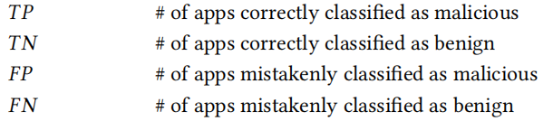
EXPERIMENTS
Experimental Setup
two datasets from Comodo Cloud Security Center:
recent collected Android apps (through January 30, 2017 to February 5, 2017), contains 1,834 training Android apps and 500 testing samples
larger sample collection containing 30,000 Android apps obtained within one month (Januray 2017)

Slide 9
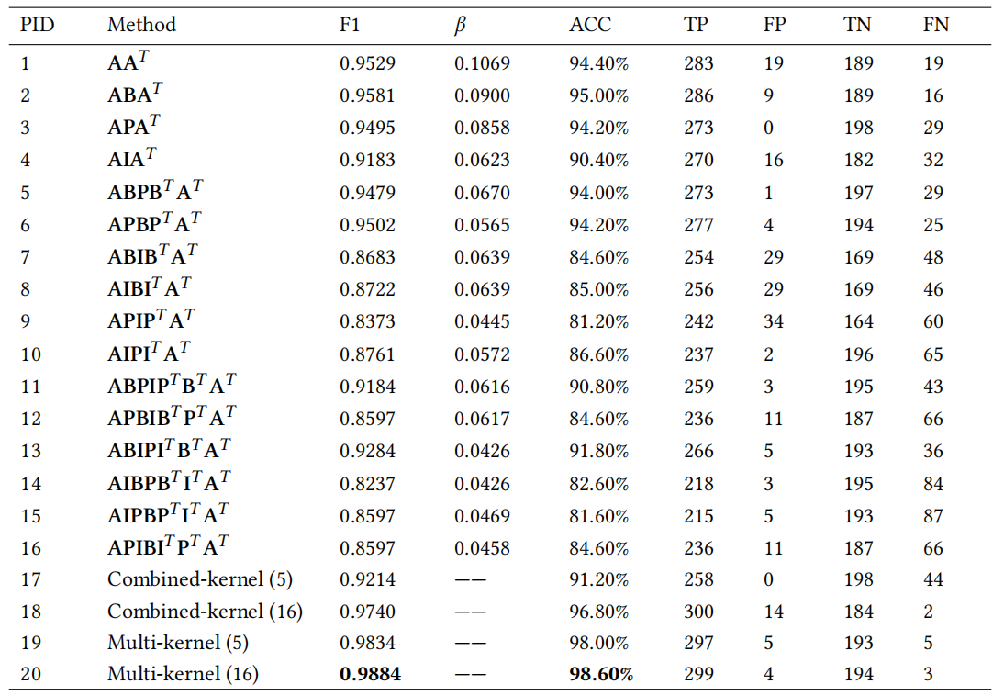
Notes:
We
select the top ve meta-paths (i.e., PID12, PID16, PID6, PID3, and PID5) and use their Laplacian scores as the weights to construct a new kernel (i.e., PID17) fed to the SVM. Similar to multi-kernel learning, if the similarity matrix is not PSD, we remove the negative eigenvalues following [26]. We also use these top ve meta-paths as the kernels and apply multi-kernel learning (described in Section 3.3) for comparison (i.e., PID19). Another set of comparison is using all the meta-paths (i.e., PID18 with combined similarity and PID20 by applying multi-kernel learning). e experimental results are shown in Table 3.

Slide 10
